Slide 1
Data Link Layer Part V: Local Area Networks and Ethernet

Slide 2
LAN (Local Area Networks)
A LAN is a computer network that covers a small area (home, office, building, campus)
a few kilometers
Usually cabling and equipments belong to the LAN owner.
A LAN consists of
Shared transmission medium
now so valid today due to switched LANs
regulations for orderly access to the medium
set of hardware and software for the interfacing devices
In TCP/IP networking, a LAN is often but not always implemented as a single IP subnet.

Slide 3
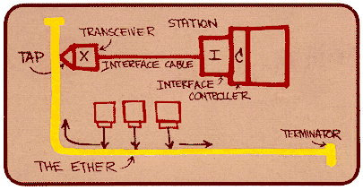
Ethernet
Original picture drawn by Bob Metcalfe, inventor of Ethernet (1972 – Xerox PARC)
Developed by Bob Metcalfe and others at Xerox PARC in mid-1970s
Roots in Aloha packet-radio network
Standardized by Xerox, DEC, and Intel in 1978
LAN standards define MAC and physical layer connectivity
IEEE 802.3 (CSMA/CD - Ethernet) standard – originally 2Mbps
IEEE 802.3u standard for 100Mbps Ethernet
IEEE 802.3z standard for 1,000Mbps Ethernet

Slide 4
Ethernet
CSMA/CD: Ethernet’s Media Access Control (MAC) policy (1-persistent CSMA/CD with binary exponential backoff)
Bandwidths: 10Mbps, 100Mbps, 1Gbps
Physical Layer:
Manchester Encoding
Bus and Star topologies are used to connect hosts
Max bus length: 2500m: 500m segments with 4 repeaters

Slide 5
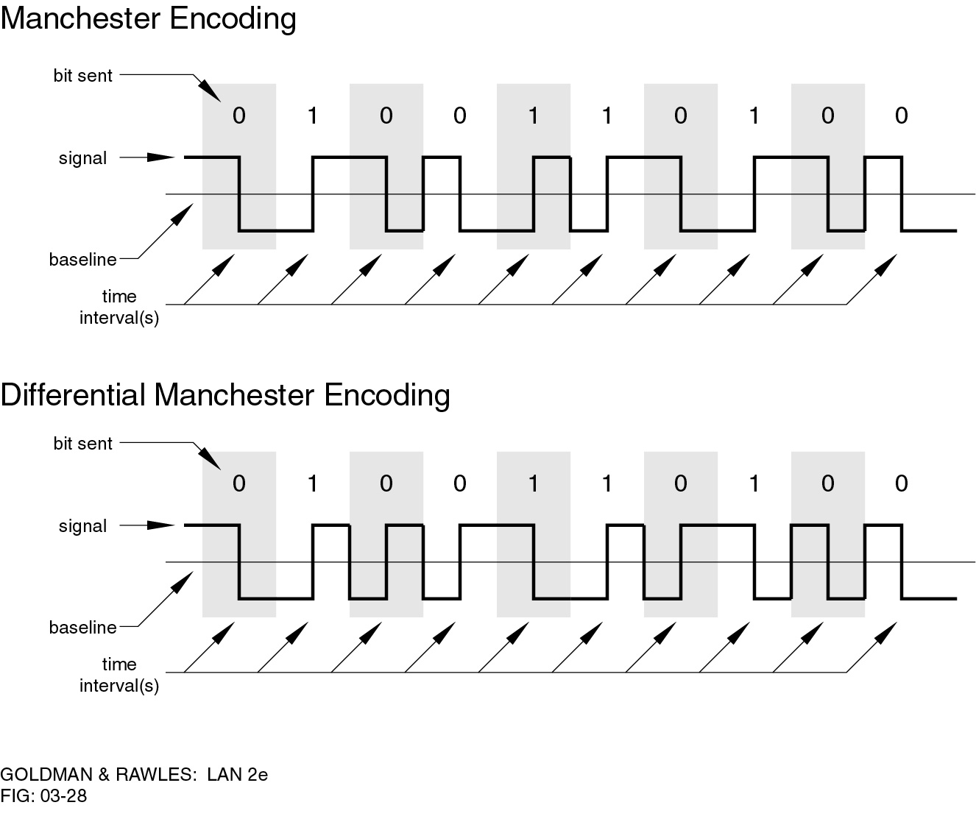
Manchester Encoding
Manchester
Transition in middle of each bit period
Transition serves as clock and data
Low to high represents one
High to low represents zero
Used by IEEE 802.3

Slide 6
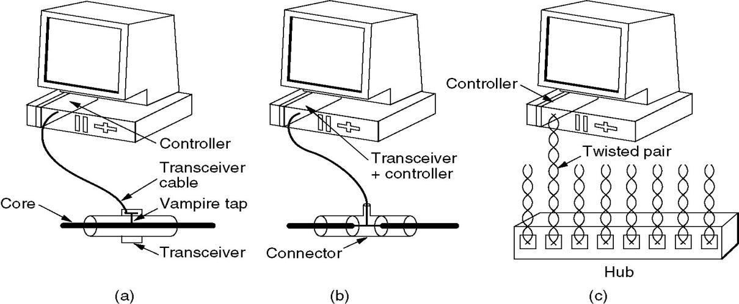
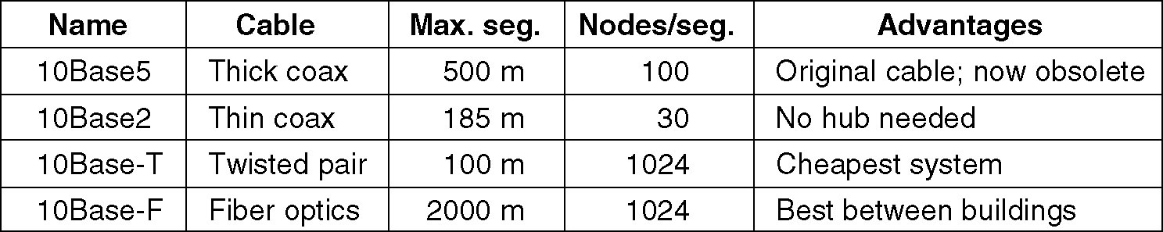
Ethernet Cabling
(a) 10Base5, (b) 10Base2, (c) 10Base-T.

Slide 7
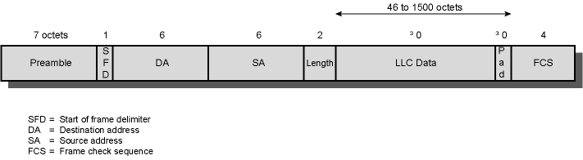
802.3 Ethernet Frame Format
Sending adapter encapsulates IP datagram (or other network layer protocol packet) in Ethernet frame
Preamble (+SFD): 7 bytes with pattern 10101010 followed by 1 byte with pattern 10101011 used to synchronize receiver
Start of Frame Delimiter (SFD): indicates start of frame (1 byte with pattern 10101011)

Slide 8
802.3 Ethernet Frame Format
Addresses: 6 bytes, frame is received by all adapters on a LAN and dropped if address does not match, globally unique address assigned by manufacturer, e.g. 8:0:e4:b1:2
Length: frame size
Pad: Zeroes used to ensure minimum frame length of 64 Bytes (WHY??)
FCS (CRC) Cyclic Redundancy Check: check sequence to detect bit errors, if error is detected, the frame is simply dropped
Body can contain up to 1500 bytes of data

Slide 9
Collision Detection
How can A know that a collision has taken place?
There must be a mechanism to ensure retransmission on collision
A’s message reaches B at time τ
B’s message reaches A at time 2τ
So, A must still be transmitting at 2τ
IEEE 802.3 specifies max value of 2τ to be 51.2μs
This relates to maximum distance of 2500m between hosts
At 10Mbps it takes 0.1μs to transmit one bit so 512 bits (64B) take 51.2μs to send
Therefore, Ethernet frames must be at least 64B long
14B header, 46B data, 4B CRC
Padding is used if data is less than 46B
To ensure that a packet is transmitted without a collision, a host must
be able to detect a collision before it finishes transmitting a packet !!

Slide 10
Ethernet CSMA/CD algorithm
1. NIC receives datagram from network layer, creates frame
2. If NIC senses channel idle, starts frame transmission If NIC senses channel busy, waits until channel idle, then transmits
3. If NIC transmits entire frame without detecting another transmission, NIC is done with frame !
4. If NIC detects another transmission while transmitting, aborts and sends jam signal. Makes sure all other transmitters are aware of collision
5. After aborting, NIC enters exponential backoff: after mth collision, NIC chooses K at random from {0,1,2,…,2^{m}-1}. NIC waits K·512 bit times, returns to Step 2. Fully freezes backoff interval at 1023 slot times after 10 attempts, and gives up altogether after 16 attempts
Bit time: 0.1 microsec for 10 Mbps Ethernet ; for K=1023, wait time is about 50 msec
Jam Signal: 48 bits

Slide 11
Ethernet’s CSMA/CD (more)
Exponential Backoff:
Goal: adapt retransmission attempts to estimated current load
heavy load: random wait will be longer
Keep delays low at low load but avoid collisions under heavy (high) load
This algorithm yields a "statistical fairness" in the sharing of bandwidth

Slide 12
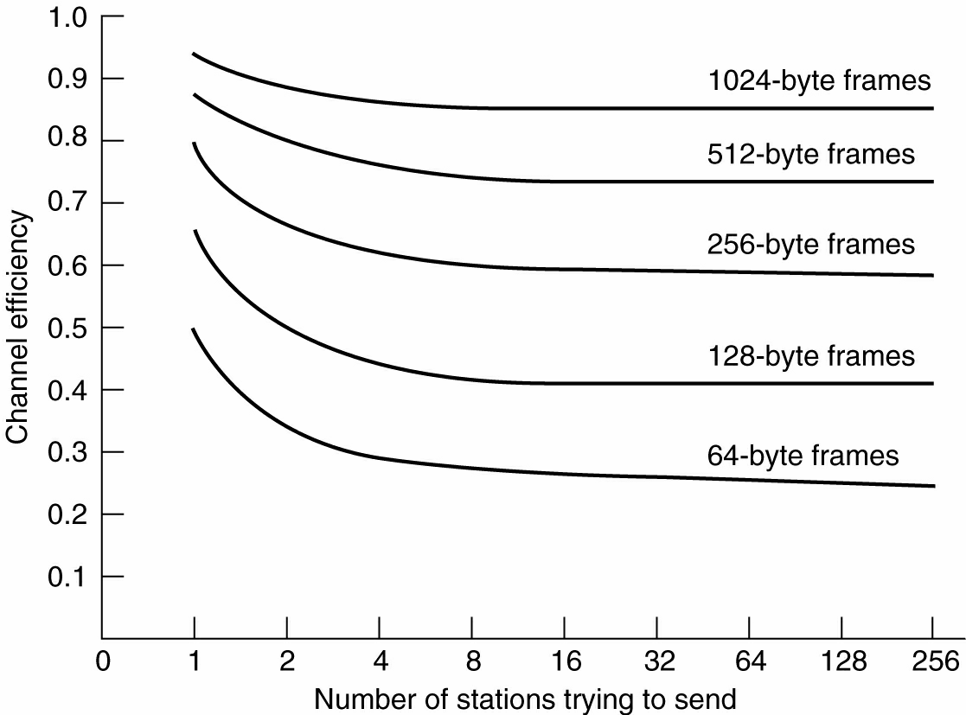
Ethernet Performance
Efficiency of Ethernet at 10 Mbps with 512-bit slot times.

Slide 13
Fast and Gigabit Ethernet
Fast Ethernet (100Mbps) has technology very similar to 10Mbps Ethernet
Uses different physical layer encoding (4B5B)
Many NIC’s are 10/100 capable
Can be used at either speed
Gigabit Ethernet (1,000Mbps)
Compatible with lower speeds
Uses standard framing and CSMA/CD algorithm
Distances are severely limited
Typically used for backbones and inter-router connectivity
Becoming cost competitive

Slide 14
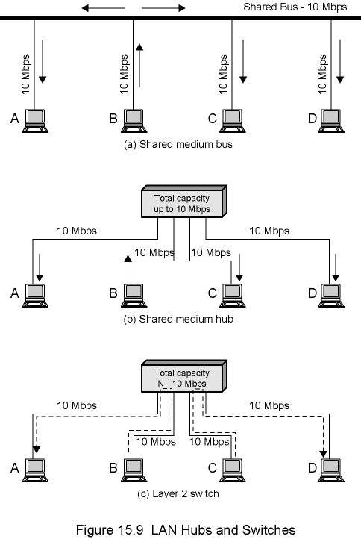
LAN Bus, Hubs and Switches
BUS AND HUB ARE LOGICALLY THE SAME
HUB AND SWITCH ARE DIFFERENT

Slide 15
Hubs
… physical-layer (“dumb”) repeaters:
bits coming in one link go out all other links at same rate
all nodes connected to hub can collide with one another
no frame buffering
no CSMA/CD at hub: host NICs detect collisions
twisted pair
hub

Slide 16
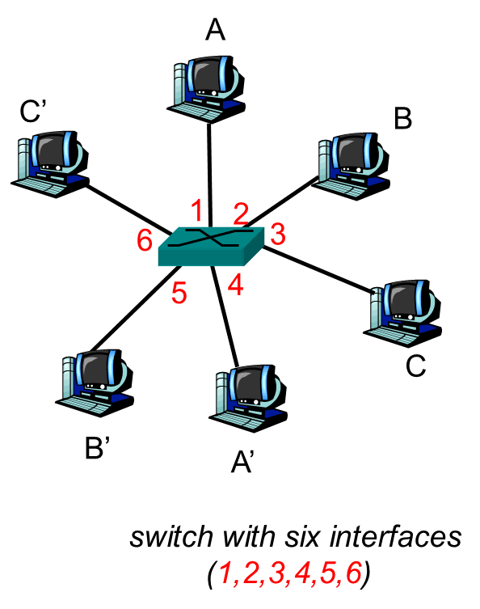
Switch/ Bridge
link-layer device: smarter than hubs, take active role
store, forward Ethernet frames
examine incoming frame’s MAC address, selectively forward frame to one-or-more outgoing links when frame is to be forwarded on segment, uses CSMA/CD to access segment
transparent
hosts are unaware of presence of switches
plug-and-play, self-learning
switches do not need to be configured

Slide 17
Switch: allows multiple simultaneous transmissions
A
hosts have dedicated, direct connection to switch
switches buffer packets
Ethernet protocol used on each incoming link, but no collisions; full duplex
switching: A-to-A’ and B-to-B’ simultaneously, without collisions
not possible with dumb hub
C’
B
1
2
6
3
5
4
C
B’
A’
switch with six interfaces
(1,2,3,4,5,6)

Slide 18
Practice: Collision domains
Switch: breaks subnet into LAN segments
Filters packets
Frame only forwarded to the necessary segments
Segments become separate collision domains

Slide 19
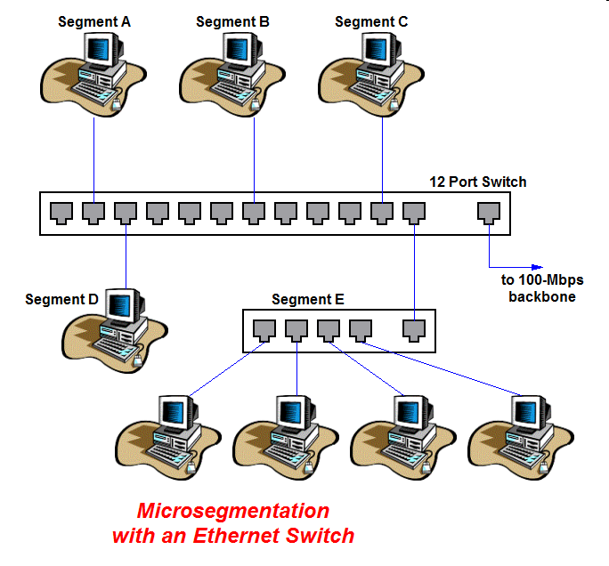
Practice: Microsegmentation
Converting shared medium Ethernet to point to point
No collisions
each link is its own collision domain
Common practice

Slide 20
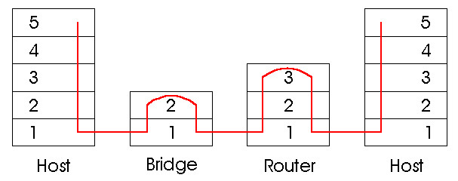
Switches vs. Routers
both store-and-forward devices
routers: network layer devices (examine network layer headers)
switches are link layer devices
There is a switch inside the router along with additional layer-3 functionality
routers maintain routing tables, implement routing algorithms
switches maintain switch tables, implement filtering, learning algorithms

Slide 21
Switch Functionality
A
C’
B
Filtering: determines whether a frame should be forwarded to some interface or should just be dropped.
Forwarding: determines the interfaces to which a frame should be directed, and then moves the frame to those interfaces.
Switch filtering and forwarding are done with a switch table.
1
2
6
3
5
4
C
B’
A’
MAC addr interface TTL
switch with six interfaces
(1,2,3,4,5,6)
A
1
60
Switch table

Slide 22
Switch Table
Q: how does switch know that A’ reachable via interface 4, B’ reachable via interface 5?
A: each switch has a switch table, each entry:
(MAC address of host, interface to reach host, time stamp)
looks like a routing table!
NOTHING LIKE LONGEST PREFIX MATCH!
Q: how are entries created, maintained in switch table?
A
C’
B
1
2
6
3
5
4
C
B’
A’
switch with six interfaces
(1,2,3,4,5,6)

Slide 23
Switch: self-learning
Source: A
Dest: A’
A
A A’
switch learns which hosts can be reached through which interfaces
when frame received, switch “learns” location of sender: incoming LAN segment
records sender/location (interface) pair in switch table
C’
B
1
2
6
3
5
4
C
B’
A’
MAC addr interface TTL
A
1
60
Switch table
(initially empty)

Slide 24
Switch: frame filtering/forwarding
When frame received:
1. record link associated with sending host
2. index switch table using MAC dest address
3. if entry found for destination then {
if dest on segment from which frame arrived then drop the frame (does not loop)
else forward the frame on interface indicated
}
else flood
forward on all but the interface
on which the frame arrived

Slide 25
Self-learning, forwarding: example
Source: A
Dest: A’
A
A A’
C’
B
frame destination unknown:
1
2
6
3
A A’
A A’
A A’
A A’
flood
A A’
5
4
destination A location known:
C
selective send
A’ A
B’
A’
MAC addr interface TTL
A
1
60
Switch table
(initially empty)
A’
4
60

Slide 26
ARP and Switches
ARP Requests are broadcast with address FF-FF-FF-FF-FF-FF
Switch forwards the ARP request to all of its ports

Slide 27
Interconnecting switches
switches can be connected together
S₄
S₁
S₃
A
S₂
F
I
B
C
D
E
G
H
Q: sending from A to G - how does S₁ know to forward frame destined to F via S₄ and S₃?
A: self learning! (works exactly the same as in single-switch case!)

Slide 28
Self-learning multi-switch example
Suppose C sends frame to I, I responds to C
1
S₄
S₁
2
S₃
A
S₂
F
I
B
C
D
E
G
H
Q: show switch tables and packet forwarding in S₁, S₂, S₃, S₄

Slide 29
Institutional network
mail server
to external
network
router
web server
IP subnet

Slide 30
Data Link Layer Part V: Local Area Networks and Ethernet

